Slide 1

EDA ON INDIAN MOVIES

Slide 2
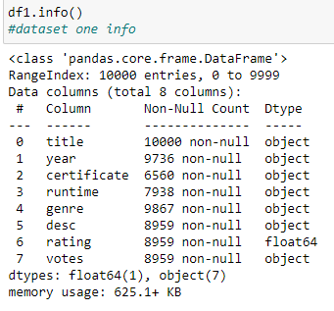
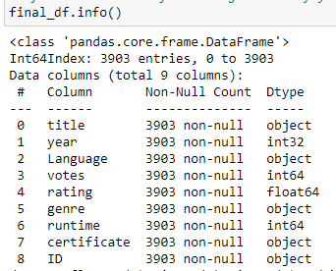
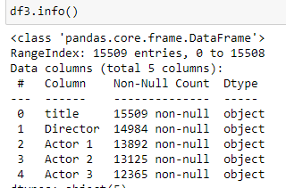
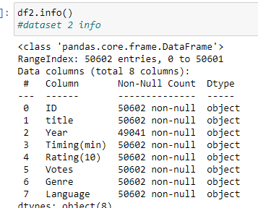
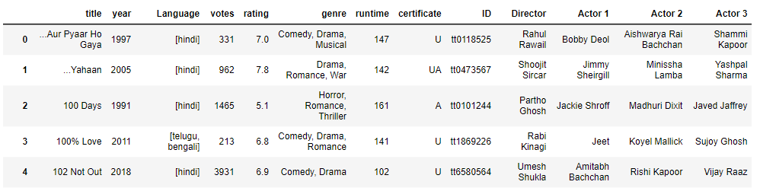
2
1
FINAL DATASET

Slide 3
EDA Points
1.Famous Actors In Indian Movies
2.Famous Directors In Indian Movies
3.Popular Genres
4.Relation Between The Votes and Rating of movies
5.Relation Between Language Count and Rating
6.Relation Between Runtime and Rating .
7.Relation Between Rating and Certificates
8.Suggesting Some Good Movies Based On Rating And Language Count

Slide 4
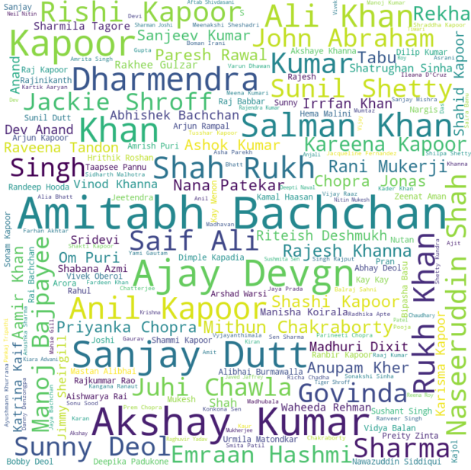
Famous Actors In Indian Movies

Slide 5

Famous Directors In Indian Movies

Slide 6

Popular Genres

Slide 7
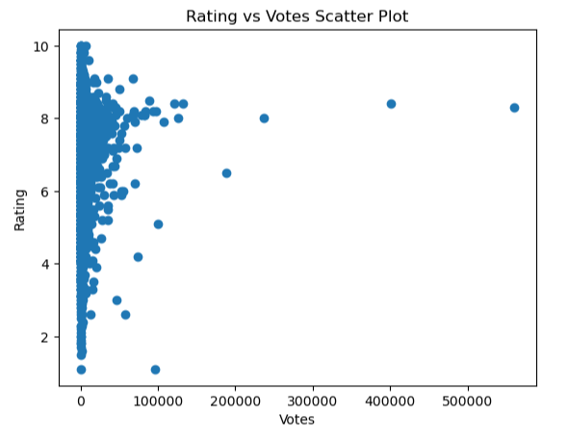
Relation Between The Votes and Rating of movies

Slide 8
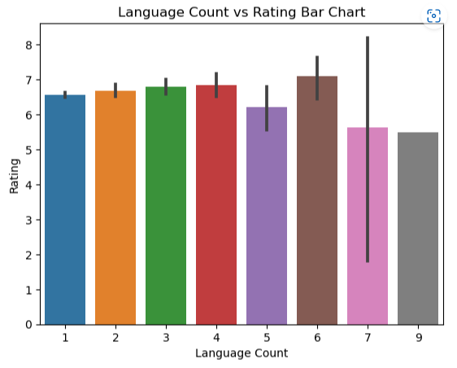
Relation Between Language Count and Rating

Slide 9
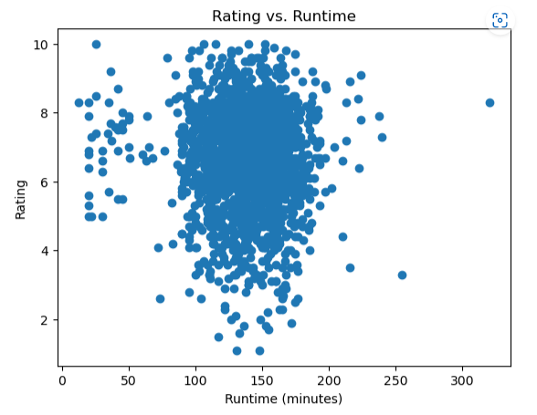
Relation Between Runtime and Rating .

Slide 10
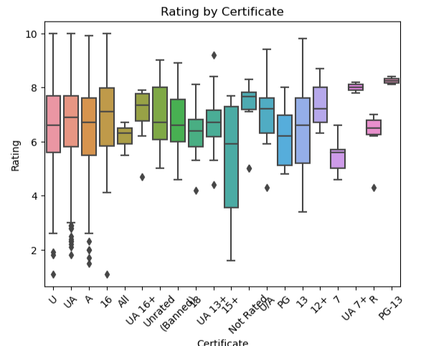
Relation Between Rating and Certificates

Slide 11
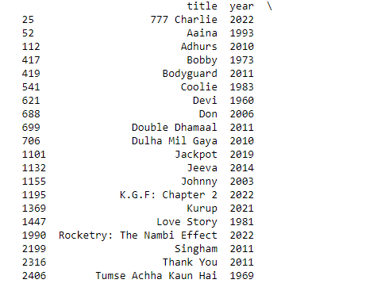
Suggesting Some Good Movies Based On Rating And Language Count

Slide 12
Thank You

